Slide 1
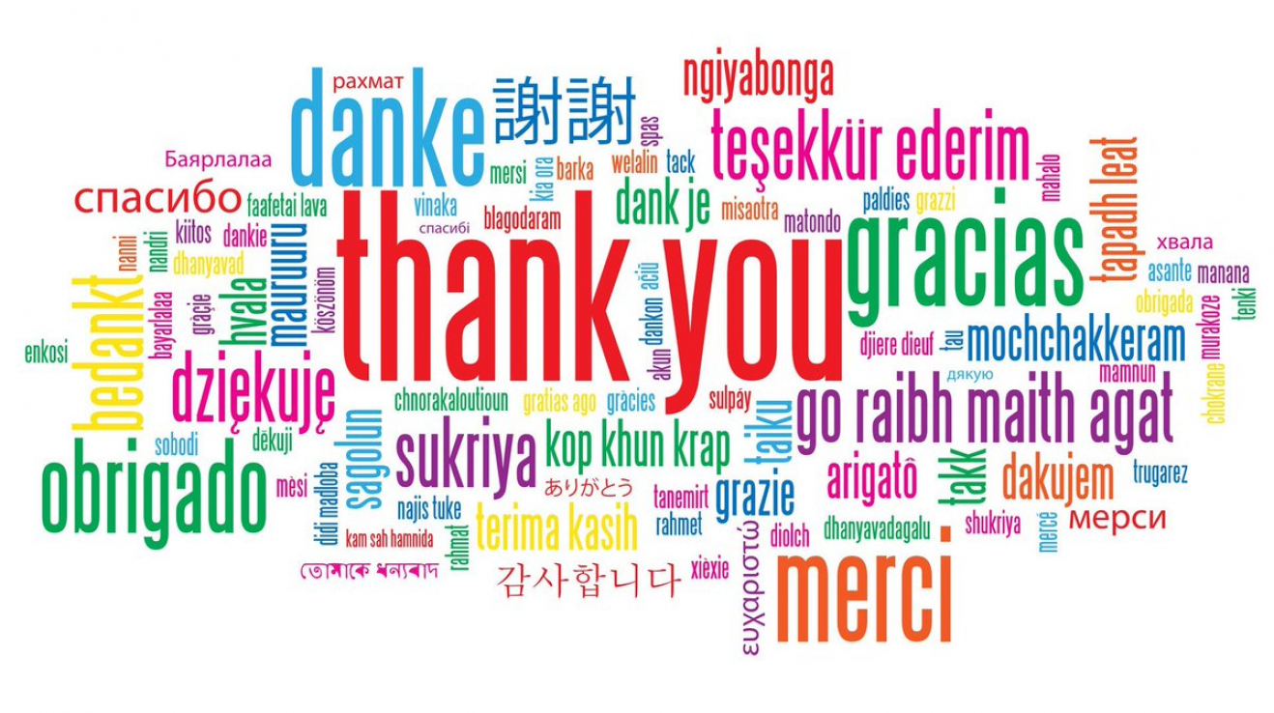
Language Quiz

Slide 2
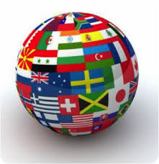
How many languages are there in the world?
Around seven thousand

Slide 3
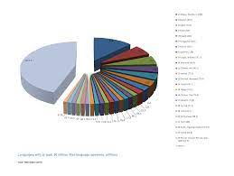
Which three languages do most people speak as native speakers?
(also try order 1-3)
Chinese 900 million
Spanish 442 million
English 378 million

Slide 4
Try to guess what the smallest number of native speakers of an existing language is.
3

Slide 5
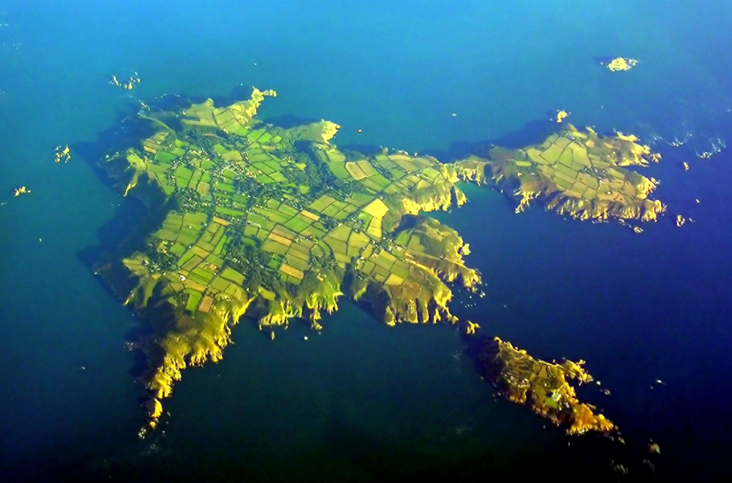
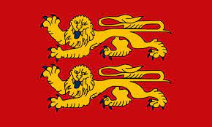
It is Sarkese, a dialect of the Norman language spoken on the island of Sark in the English Channel.

Slide 6
What is it:
Natural language
Artificial language

Slide 7
Natural language - it arose through long development over centuries, within a community - a tribe, a nation
An artificial language - created on purpose, in a short time, can even have one author. You can also invent your own language.

Slide 8
What do you think these words mean:
eka
dve
trayas
chatvāras
pañch
shash
sapta
ashta
nava
dasha

Slide 9
Vedic Sanskrit English
eka one
dve two
trayas three
chatvāras four
pañch five
shash six
sapta seven
ashta eight
nava nine
dasha ten

Slide 10
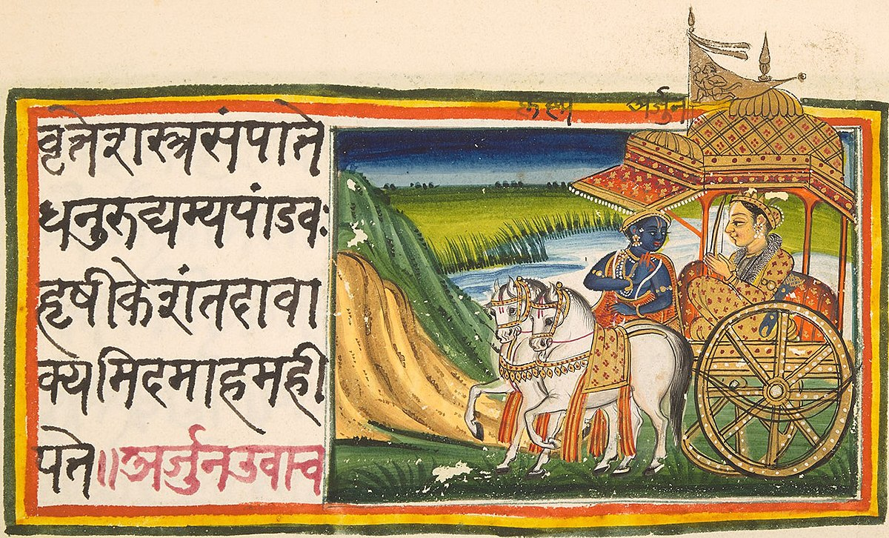
Vedic Sanskrit is considered one of the oldest languages in the world. It was already spoken almost 4 thousand years ago in India.
The similarity with English is not accidental.
Both languages belong to the group of so-called Indo-European languages, so they are related.

Slide 11
Most languages have not only a spoken but also a written form – they are recorded with a system of signs.
Try to guess which languages are involved in these cases:

Slide 12
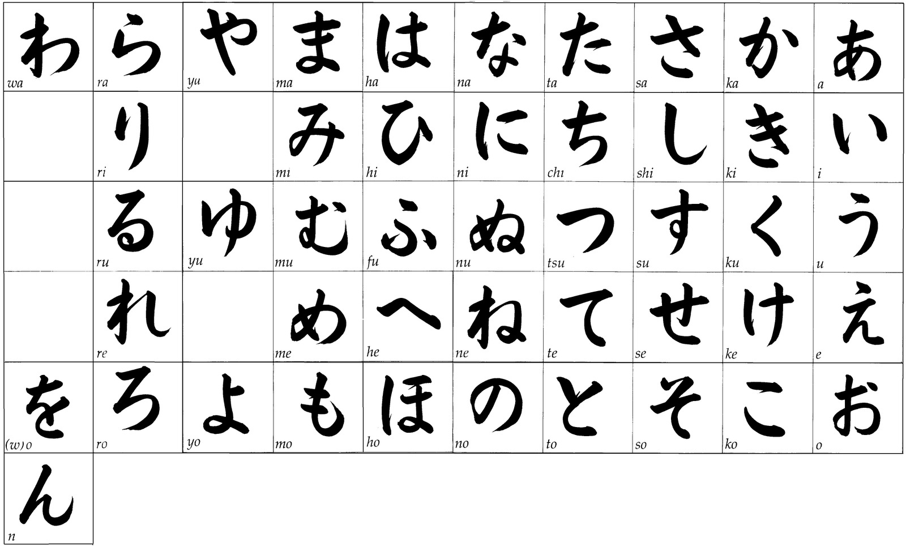
1

Slide 13
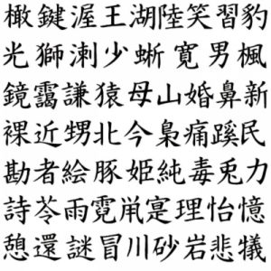
2

Slide 14
3

Slide 15
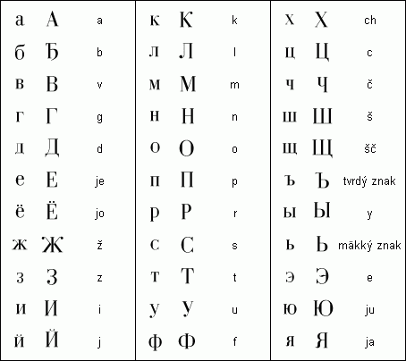
4

Slide 16
1 – Japanese
2 – Chinese
3 – Arabic
4 - Ukrainian

Slide 17
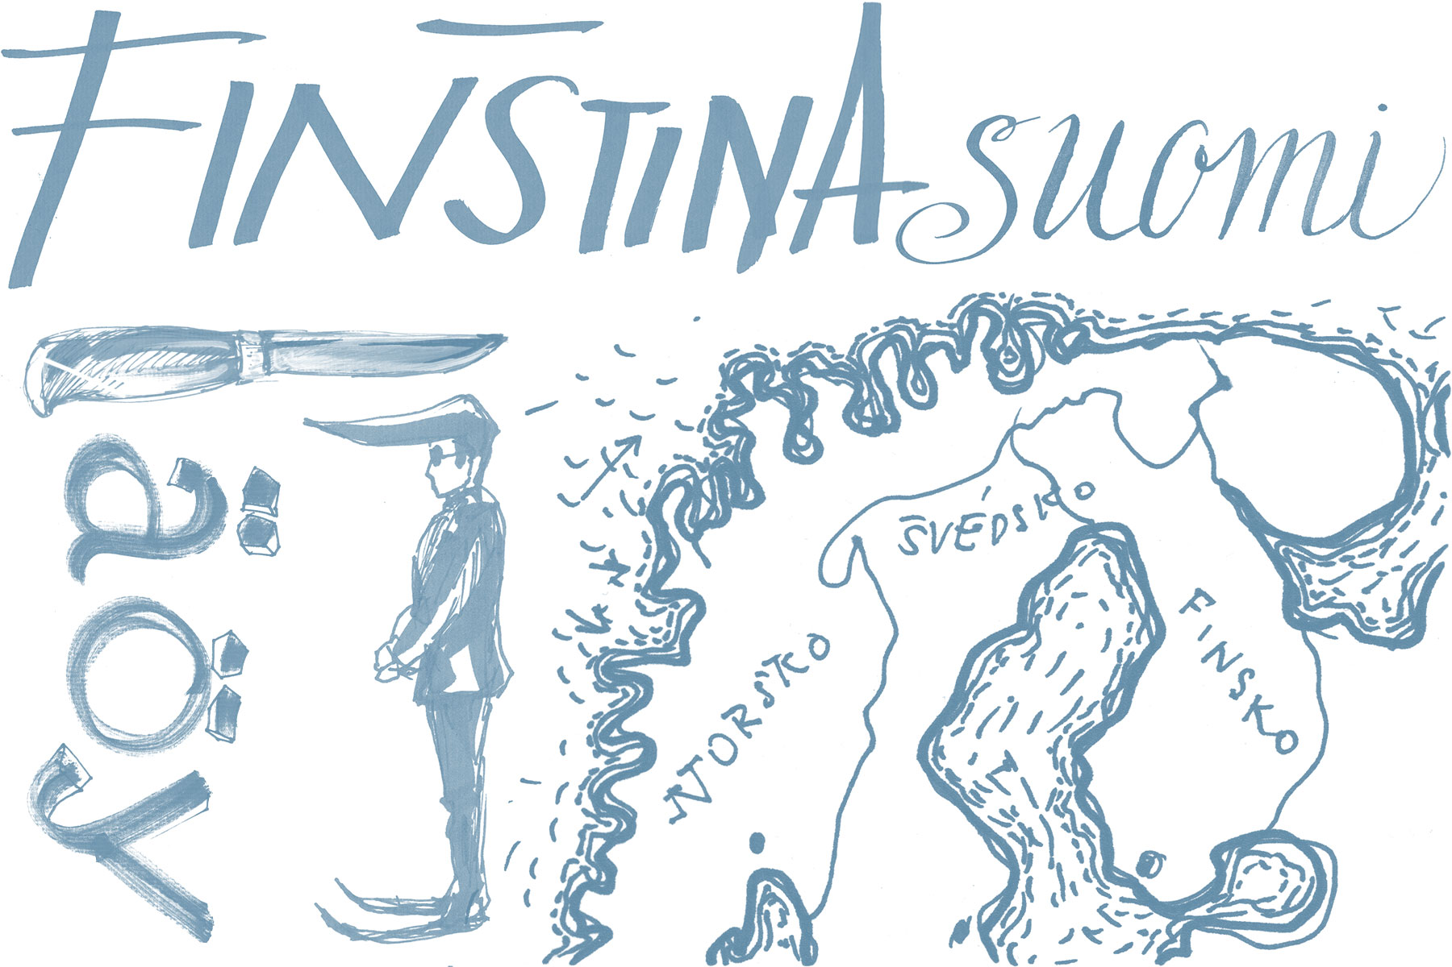
Epäjärjestelmällisyydellistyttämättömyydellänsäkäänköhän
This is said to be the longest word (uncompounded!) of a single European language. Which one?
Finnish

Slide 18
For example, how many letters could the longest Czech word have?
30
nejneobhospodařovávatelnějšími

Slide 19
Guess what is the highest number of cases in a language.
64 – 152
Tsez language (also known as dido), spoken in parts of Russia

Slide 20
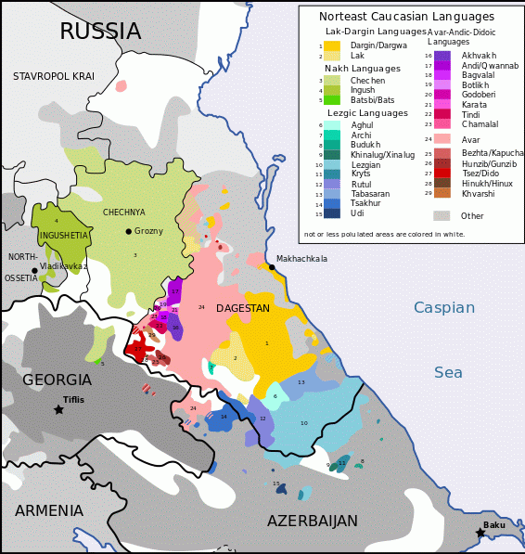

Slide 21
Try to guess how many words the language with the richest vocabulary can have and vice versa with the poorest vocabulary.
English - 990 thousand words
Taki Taki (Suriname) -340 words

Slide 22
Thanks for your attention.

